Slide 1
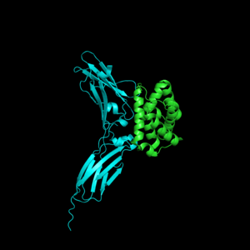
Introduction to Biomolecular Structure
Concerned Book Chapter: CHAPTER 13 Protein Structure
S. Ravichandran, Ph.D. Biology,
Hood College, Frederick, MD 21701

Slide 2
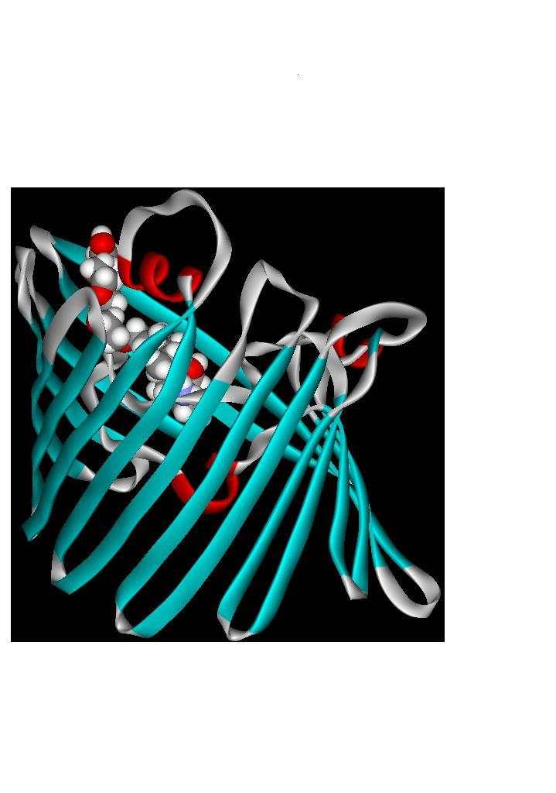
Overview of the class
Biopolymer structures
DNA/RNA and protein
Subunit components and their chemistry
Proteins
Primary/secondary/Tertiary/Quarternary
Porin Using DSViewerPro

Slide 3
Overview of the class
Databases
PDB
Protein structure Quality Assessment
Hands-on exercise
Porin Using DSViewerPro

Slide 4
So far
Biology/Biochemistry
Central Dogma, Codon Models, Laws of Segregation, Mitosis, Meiosis and Mutations
How the Biological data is laid out and available?
Conventions (5’ to 3’)
Positive/Negative Strand
Sequence formats
Fasta, VCF etc.

Slide 5
So far
DNA, RNA (GenBank, Ensembl)
NM_, NR_, XM_, XR_
Protein (UniProt, NCBI)
NP_, XP
How to search and extract sequences?
How to compare DNA/Protein sequences?

Slide 6
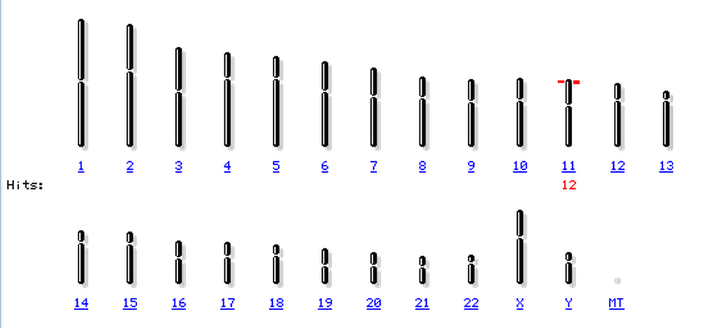
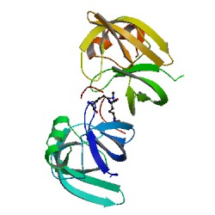
Exon
Intron
Exon
Protein (1D)
Gene
Drugs/Inhibitor
Experimental, if not ???????
Impact on Function ???????
Mutations
Chromosome
Protein (3D)

Slide 7
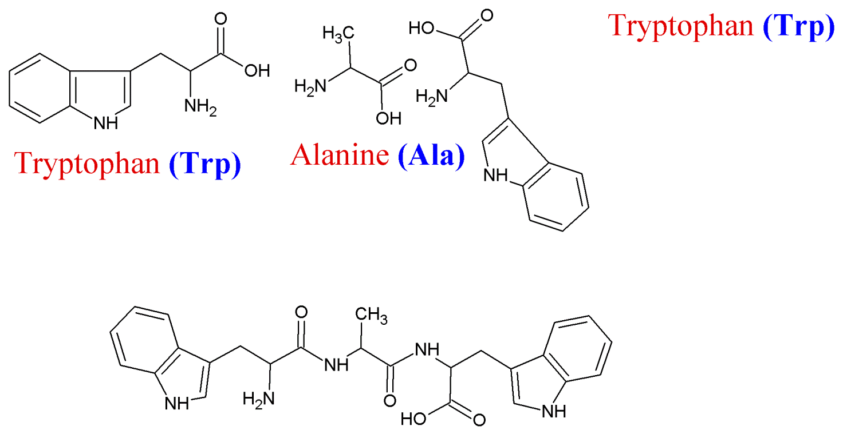
Proteins are polymers Amide Bond Chemistry
Elimination of a water molecule

Slide 8
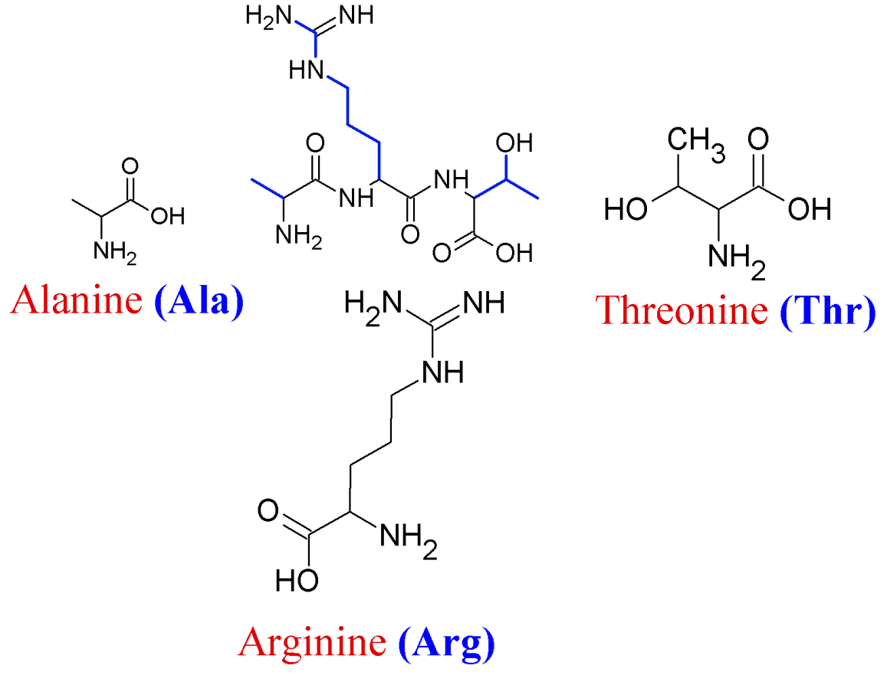
v
v
v
α
omega
α
Phi
Psi
Omega: 0º or 180º (mostly) Phi -50º in a α-helix Phi: -50º to -160º in a β-sheet Psi -50º a-helix
Psi: +100º to +180º beta-sheet
RAMACHANDRAN GN, RAMAKRISHNAN C, SASISEKHARAN V (July 1963). "Stereochemistry of polypeptide chain configurations". J. Mol. Biol. 7: 95–9.

Slide 9
Primary Structure
>1STP:A|PDBID|CHAIN|SEQUENCE DPSKDSKAQVSAAEAGITGTWYNQLGST FIVTAGADGALTGTYESAVGNAESRYVL TGRYDSAPATDGSGTALGWTVAWKNNYR NAHSATTWSGQYVGGAEARINTQWLLTS GTTEANAWKSTLVGHDTFTKVKPSAASI DAAKKAGVNNGNPLDAVQQ

Slide 10
Secondary Structures and beyond
How the primary structures fold (locally)?

Slide 11
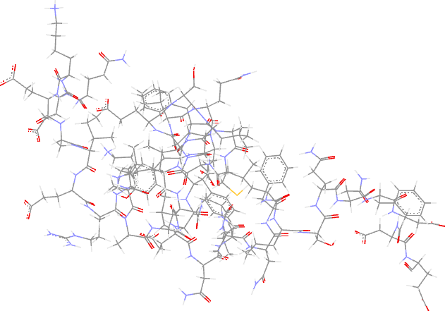
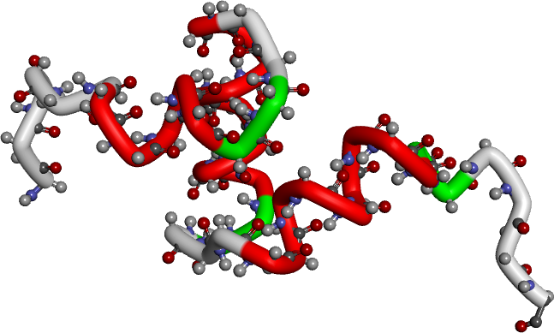
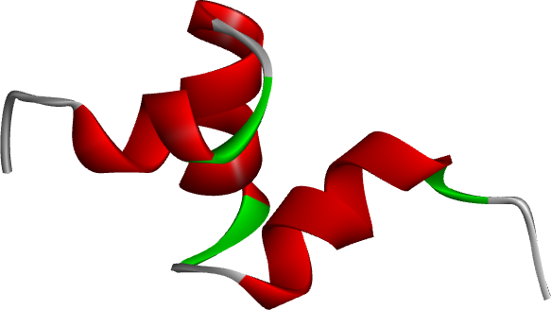
Alpha Helix
1UBA-1st model

Slide 12
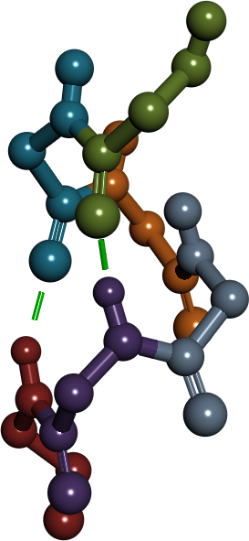
Alpha Helix
1-E16
2-S17
3-L18
Note the first amino acid and the fifth amino acid backbone form H-bonds
C=0 and N-H → C=O---H--N
4-V19
The small helix is part of the 1UBA structure
E¹⁶SLVIQ²¹
E¹⁶-S-L-V-I²⁰ and S¹⁷-L-V-I-Q²¹ The E¹⁶ carbonyl (C=O) forms H-bond with I²⁰ (-NH) group The S¹⁷ will form H-bond with Q²¹
etc,
5-I20
6-Q21

Slide 13
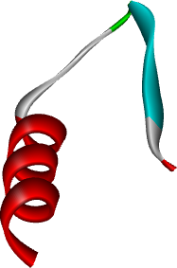
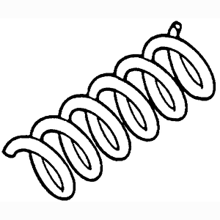
Alpha Helix
Most common is right-handed
Each turn has 3.6 amino acids
Average length of helix is ~10 aa but varies from 5 – 40 (1.5 to 11 turns) (Source: Mount Bioinformatics Book)
What residues are expected?
Regions with more A, E, L, M
Regions with less P, G, Y and S
P is known to be a helix breaker but is observed to be present in longer helices (forming a kink)
Each turn has 3.6 amino acids

Slide 14
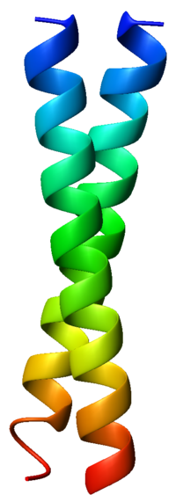

Right handed helix
Helix is spiraling upwards in the thumb direction
RHH
Left Handed (not shown) is the opposite of right-handed case
Counter-clock wise

Slide 15
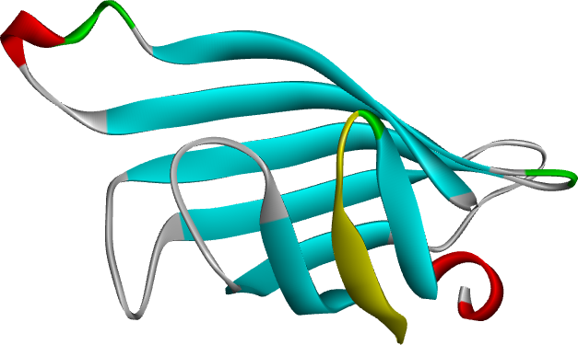
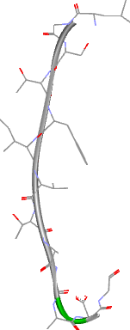
Beta Sheet
L25
PDB: 1STP
G37

Slide 16
Beta Sheet
Forms H-bonds between two sheets that could be parallel or anti-parallel

Slide 17
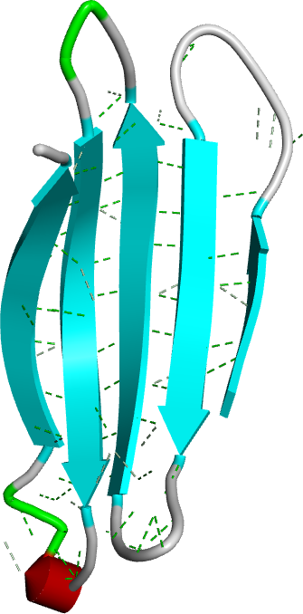
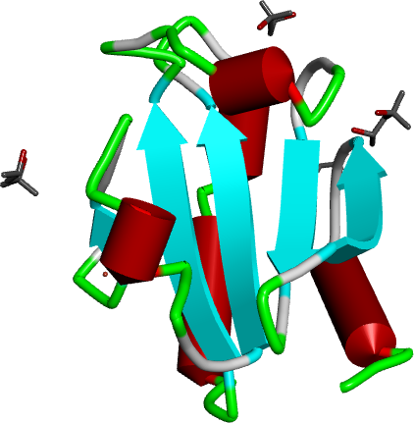
Part of 1STP Structure
PDB: 2TRX

Slide 18
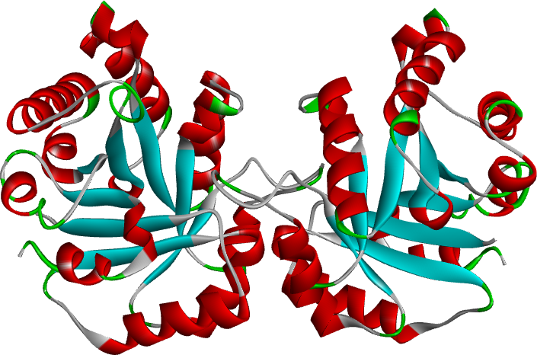
Loop and Turns
PDB: 2jk2

Slide 19
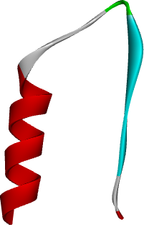
Helix-Turn-Sheet
Turn
helix
Beta-sheet

Slide 20
SCOP2
SCOP2 Classification
Protein relationships, Structural classes, Protein types, and Evolutionary events.

Slide 21
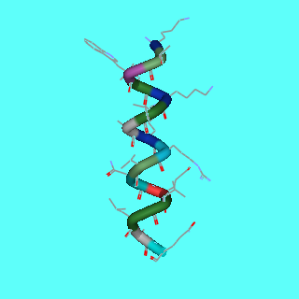
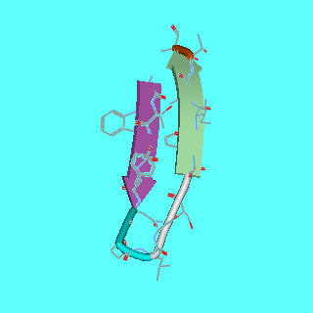
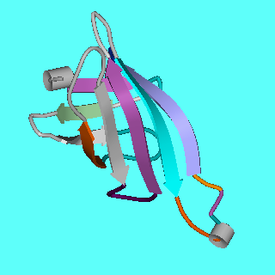
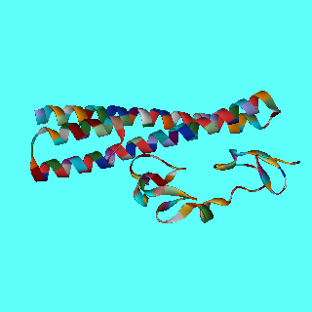
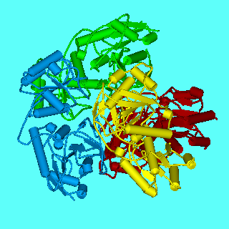
MAPRRVRSFL RGLPALLLLL LFLGPWPAAS HGGKYSREKN
Primary
Secondary Structure (& loop)
Tertiary Structure
1STP
1STP
Chunk From 1WSA
Quarternary Structure
2fcw
1WSA (A,B,C,D)
Quinternary (Protein-Protein/Protein-DNA)
RAP
LDLR

Slide 22
Protein Structure Classification
Based on Levitt and Chothia (1976)
Class alpha (α)
Made up of alpha helices with loops
Class beta (β)
Made up of beta sheets
Examples of this class are Anti bodies, Enzymes etc
Class alpha/beta (α/β)
Mostly parallel beta along with alpha (mostly occurs in-between)

Slide 23
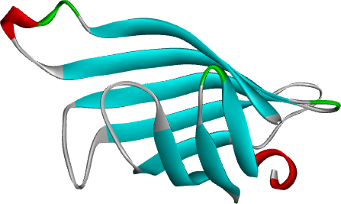
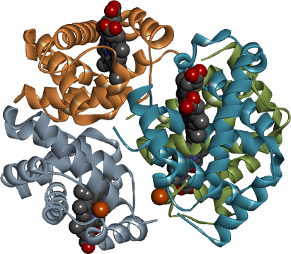
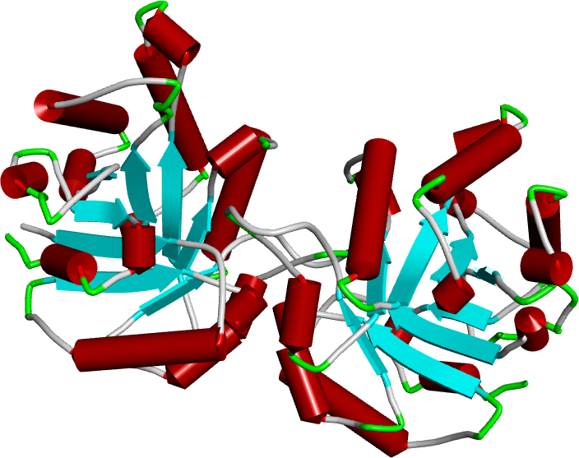
Class beta-1STP; mostly antiparallel beta sheets
Alpha class-PDB: 3hhb Alpha helices joined by loops mostly on the surface
Class Alpha/beta-2jk2: Mostly parallel beta sheets along with intervening alpha helices

Slide 24
What are domains?
Super-secondary structures
Domains can independently exist
Functional units

Slide 25
Protein Structure Determination: Experimental Methods
3D arrangement of amino acid residues

Slide 26
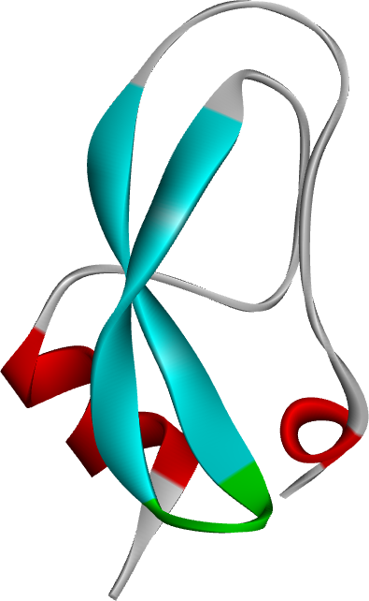
X-ray Source
Electron Density Map
Crystal Structure
Diffraction Pattern
fitting
Grow Crystals (Lab)
Model

Slide 27
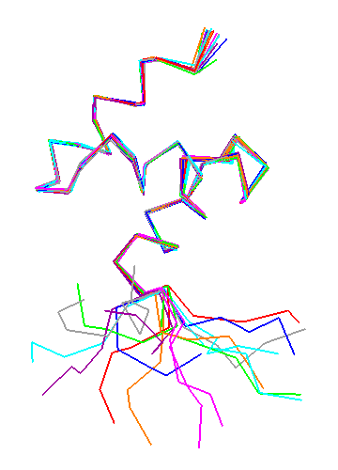

3D-Structural Database of biomolecules (PDB) http://www.rcsb.org
NMR: 1DV0 C-Ter UBA Domain
NMR (eary 1960s)
Dynamic
Multiple Models (Each conformation is a model)
Aqueous environment
Limitations
Size of molecule
< 30kD
Examples
1DV0, 1UBA
X-ray (1958) (>85% of PDB)
Static
Only one model
Crystal
Limitations
Not limited by size
Examples
7LYZ , 2SRC

Slide 28

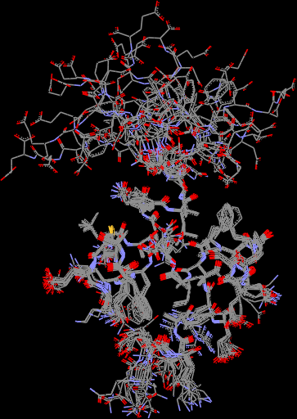
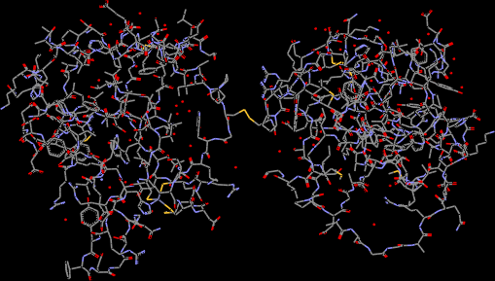
NMR Structure of C-terminal UBA domain of the human homologue of RAD23A (HHR23A)
CT
1DV0
2G43
Ubiquitin Binding Domain (UBP) from deubiquitinating enzyme isopeptidase T (IsoT)
NT

Slide 29
02/18/2015: 99134 Structures
Monotopic Membrane Proteins: 453
Year | X-ray | NMR | e- Micr.
1976 | 13 | 0 (until 1988) | 0 (until 1996)
1990 | 488 | 9 | 0
2005 | 28824 | 5132 | 116
2007 | 40613 | 6962 | 167
2009 | 53650 | 8190 | 264
2011 | 62110 | 8800 | 353
2018 | 125271 | 12206 | 2110
1971: myoglobin (1958), hemoglobin (1963), egg-white lysozyme (1965), ribonucleases A and S (1967), papain (1968), and insulin (1971).

Slide 30
Simulation of DNA Model
You can take the DNA/Protein model and
Add ions
Add water
Energy minimization
MD simulations
Create movies
See them in VMD

Slide 31
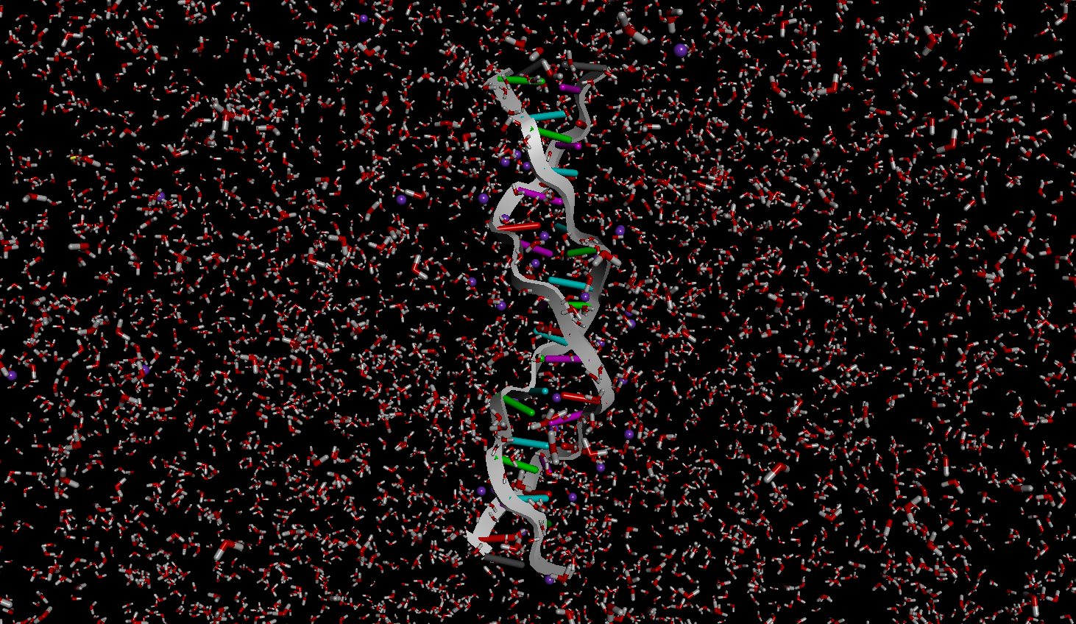
DNA Model soaked with water
You can take the DNA model and
Add ions
Add water
Energy minimization
MD simulations
Create movies
See them in VMD

Slide 32
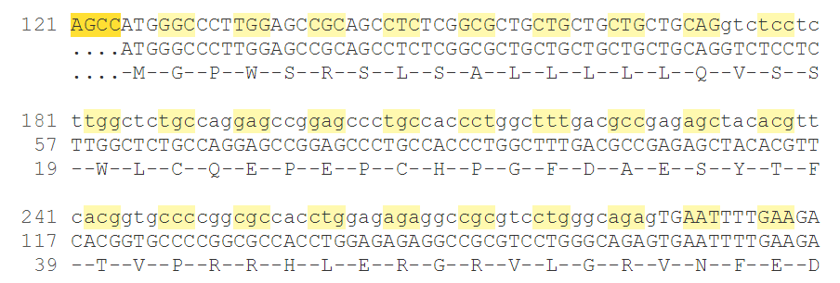
So far,
DNA/Protein sequence information in Fasta
Corresponding 3D information in what format ???

Slide 33
Anatomy of PDB file
Atom #
Residue #
Residue
ATOM 1 N MET B 1 52.127 -7.410 40.963 1.00 52.97
ATOM 2 CA MET B 1 51.096 -6.600 40.340 1.00 52.20
ATOM 3 C MET B 1 51.305 -6.416 38.831 1.00 51.74
ATOM 4 O MET B 1 52.405 -6.086 38.379 1.00 50.94
ATOM 5 CB MET B 1 51.012 -5.245 41.044 1.00 52.27
ATOM 6 CG MET B 1 50.777 -5.353 42.542 1.00 50.84
ATOM 7 SD MET B 1 49.355 -6.390 42.934 1.00 51.51
ATOM 8 CE MET B 1 48.078 -5.169 43.363 1.00 47.75
ATOM 9 OXT MET B 1 50.932 -9.312 40.816 1.00 53.41
ATOM 11 N ASN B 2 50.235 -6.630 38.064 1.00 50.80
ATOM 12 CA ASN B 2 50.271 -6.496 36.613 1.00 49.26
ATOM 13 C ASN B 2 50.332 -5.038 36.246 1.00 48.37
ATOM 14 O ASN B 2 50.120 -4.673 35.089 1.00 50.24
ATOM 15 CB ASN B 2 49.016 -7.074 35.977 1.00 49.62
ATOM 16 CG ASN B 2 48.753 -8.479 36.395 1.00 51.39
ATOM 17 OD1 ASN B 2 49.628 -9.339 36.316 1.00 51.26
ATOM 18 ND2 ASN B 2 47.531 -8.701 36.861 1.00 54.69
...........
HETATM 2462 ZN ZN 909 45.731 9.445 45.851 0.54 77.21
HETATM 2463 C1 RET B 978 33.234 8.591 25.798 1.00 34.05
HETATM 2464 C2 RET B 978 31.995 8.387 24.968 1.00 33.95
HETATM 2465 C3 RET B 978 32.242 8.645 23.513 1.00 33.45
HETATM 2466 C4 RET B 978 32.720 10.104 23.258 1.00 33.69
HETATM 2467 C5 RET B 978 33.717 10.591 24.302 1.00 34.43
HETATM 2468 C6 RET B 978 33.938 9.900 25.443 1.00 34.95
HETATM 2469 C7 RET B 978 34.915 10.362 26.451 1.00 36.11
Only portion of the file is shown
Temp Factor
X Y Z
Occ
Chain ID

Slide 34
Quality of Models
B-factor, Occupancy and Conformation(s)

Slide 35
Occupancy Factors
Frequency with which a particular atom is present in the Crystal Structure
There could be alternate conformations resulting in multiple possible positions (ex 28% and 72%)
Partial occupancy: Ligands and metal-ions only partially visible
55 - 60 Real(6.2) Occupancy.
Example from RCSB Documentation
1 2 3 4 5 6 7 8
12345678901234567890123456789012345678901234567890123456789012345678901234567890
ATOM 145 N VAL A 25 32.433 16.336 57.540 1.00 11.92 A1 N
ATOM 146 CA VAL A 25 31.132 16.439 58.160 1.00 11.85 A1 C
ATOM 147 C VAL A 25 30.447 15.105 58.363 1.00 12.34 A1 C
ATOM 148 O VAL A 25 29.520 15.059 59.174 1.00 15.65 A1 O
ATOM 149 CB AVAL A 25 30.385 17.437 57.230 0.28 13.88 A1 C
ATOM 150 CB BVAL A 25 30.166 17.399 57.373 0.72 15.41 A1 C
ATOM 151 CG1AVAL A 25 28.870 17.401 57.336 0.28 12.64 A1 C
ATOM 152 CG1BVAL A 25 30.805 18.788 57.449 0.72 15.11 A1 C
ATOM 153 CG2AVAL A 25 30.835 18.826 57.661 0.28 13.58 A1 C
ATOM 154 CG2BVAL A 25 29.909 16.996 55.922 0.72 13.25 A1 C

Slide 36
Occupancy and Conformations
Individual molecules can show slight conformational differences in a crystal. In that case the corresponding atoms are given a lower occupancy factor (most atoms 1 and these multiple conformational ones have a lower one and the multiple conformations add to 1)
Example 1AGM
55 - 60 Real(6.2) Occupancy.

Slide 37
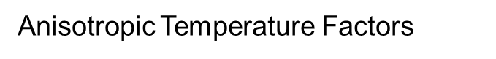
Temperature Factors or B-Factor
Ideal non-moving atom shows a Gaussian like behavior. But, atom in a molecule shows a slightly diffuse picture. These properties are modeled using a variable called “Temperature Factor”
A value < 10 produce an atom model that is less diffuse. The atom is present in a similar position in all the copies of the molecules
A value > 50 indicates a moving atom (mobile atom)-the position is less defined and diffuse

Slide 38
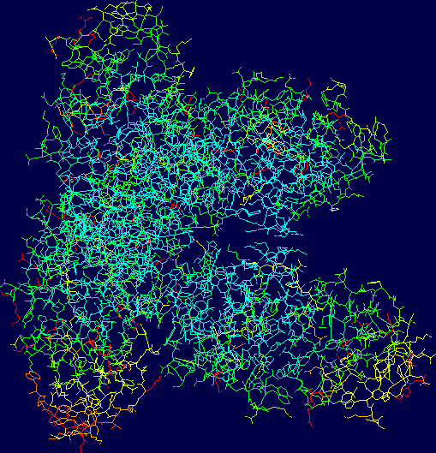
Columns 61 - 66 ; Temperature factor
PDB:
1HYY
Note the
Difference
Between
Core and Surface
from dark blue for low B-factor to red for high B-factor.

Slide 39
Temperature Factors or B-Factor
Example:
1 2 3 4 5 6 7 8
12345678901234567890123456789012345678901234567890123456789012345678901234567890
ATOM 145 N VAL A 25 32.433 16.336 57.540 1.00 11.92 A1 N
ATOM 146 CA VAL A 25 31.132 16.439 58.160 1.00 11.85 A1 C
ATOM 147 C VAL A 25 30.447 15.105 58.363 1.00 12.34 A1 C
ATOM 148 O VAL A 25 29.520 15.059 59.174 1.00 15.65 A1 O
ATOM 149 CB AVAL A 25 30.385 17.437 57.230 0.28 13.88 A1 C
ATOM 150 CB BVAL A 25 30.166 17.399 57.373 0.72 15.41 A1 C
ATOM 151 CG1AVAL A 25 28.870 17.401 57.336 0.28 12.64 A1 C
ATOM 152 CG1BVAL A 25 30.805 18.788 57.449 0.72 15.11 A1 C
ATOM 153 CG2AVAL A 25 30.835 18.826 57.661 0.28 13.58 A1 C
ATOM 154 CG2BVAL A 25 29.909 16.996 55.922 0.72 13.25 A1 C
Columns 61 - 66 ; Temperature factor

Slide 40
Exptl Structures are not always Perfect
Ramachandran Plot
Unsatisfied HB donors
HIS, ASN, GLN side chain flips
Atom Bumps
Unusual Bond lengths, Torsion angles etc.
Chirality issues
Coordinate issues
Atom nomenclature issues

Slide 41
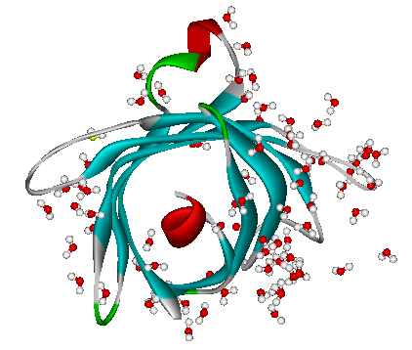
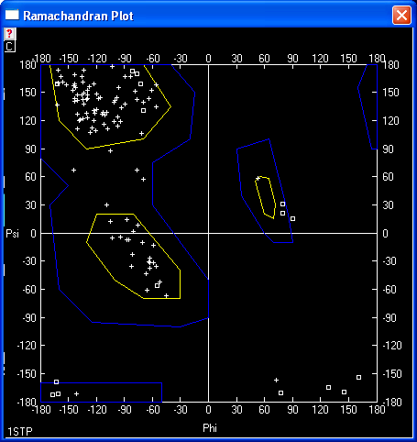
Why Structure Prediction is Difficult?
Squares: Gly
Assume 2 angles 3² = 9. 50 amino acid protein,
the total # conformations
=> 9⁵⁰ = ~5.2 x 10⁴⁷
1STP
β-Sheet
α
Left-handed α-helix
omega
α
Phi
Psi
Right handed α-helix
RAMACHANDRAN GN, RAMAKRISHNAN C, SASISEKHARAN V (July 1963). "Stereochemistry of polypeptide chain configurations". J. Mol. Biol. 7: 95–9.
DeepView 3.7

Slide 42
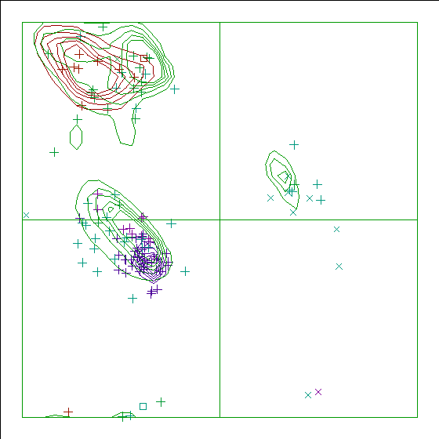
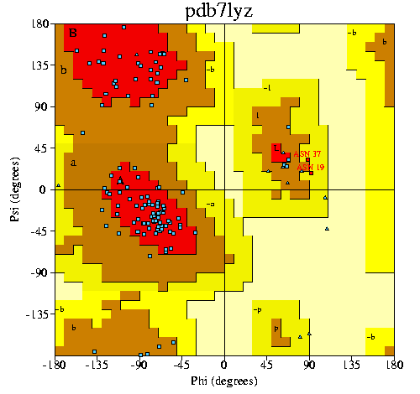
Quality (model) check!
Procheck: Stereo-chemical quality of the protein and residue by residue analysis in figures http://www.ebi.ac.uk/thornton-srv/software/PROCHECK/
PDBREPORT: http://swift.cmbi.ru.nl/gv/pdbreport/

Slide 43

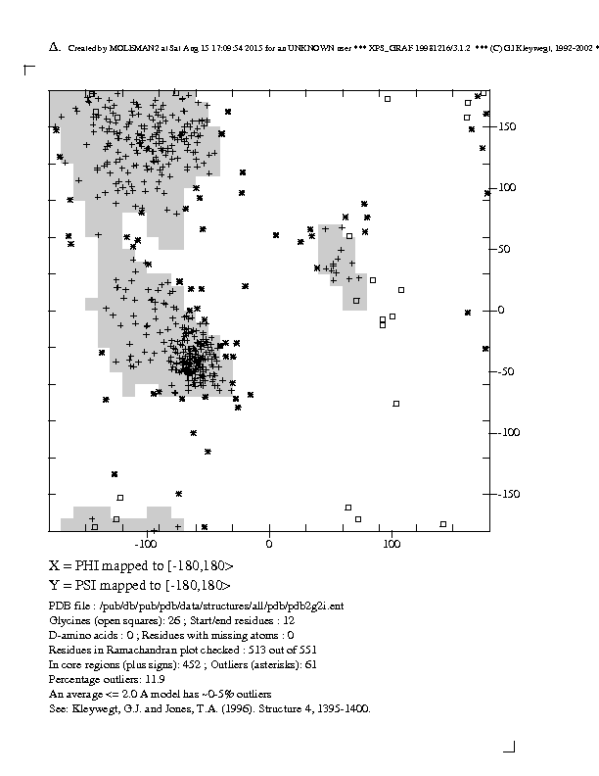
http://eds.bmc.uu.se/eds/ramachan.html
2G2I Resolution > 3.12 Ang
Look at the % of outliers to access the quality of the structure
11.9%

Slide 44
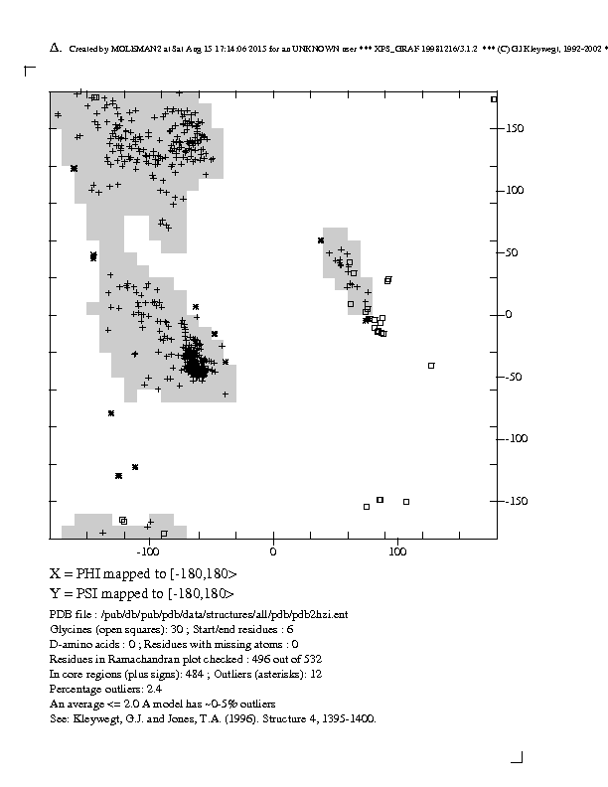
http://eds.bmc.uu.se/eds/ramachan.html
PDB ID: 2hzi
Look at the % of outliers to access the quality of the structure
2.9%

Slide 45
PDB: Complete Structure?
Just because you have a structure entry doesn’t mean that
It has all the residues from end-to-end
O95696; 1058 total length; only fragments are solved
All the atoms
Only alpha carbons; 1f6g
ATOM 1 CA MET A 1 3.492 3.121 59.151 1.00 0.00 C
ATOM 2 CA PRO A 2 6.043 5.372 57.455 1.00 0.00 C
ATOM 3 CA PRO A 3 7.095 2.832 54.786 1.00 0.00 C
ATOM 4 CA MET A 4 3.532 1.921 53.915 1.00 0.00 C
ATOM 5 CA LEU A 5 2.613 5.557 53.443 1.00 0.00 C
ATOM 6 CA SER A 6 5.641 6.166 51.259 1.00 0.00 C
ATOM 7 CA GLY A 7 4.784 3.239 49.020 1.00 0.00 C
ATOM 8 CA LEU A 8 1.243 4.494 48.588 1.00 0.00 C
ATOM 9 CA LEU A 9 2.481 7.928 47.597 1.00 0.00 C
ATOM 10 CA ALA A 10 4.813 6.418 45.031 1.00 0.00 C

Slide 46
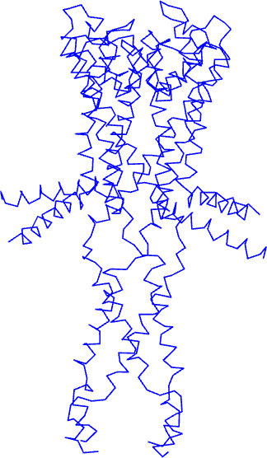
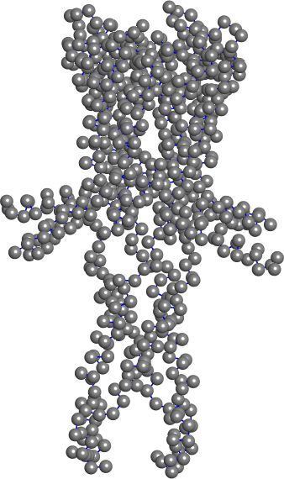
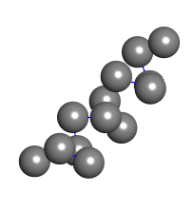
Hands-on
PDB: 1f6g

Slide 47
No Structure
Many membrane proteins are difficult to crystallize
ex hOCT1

Slide 48
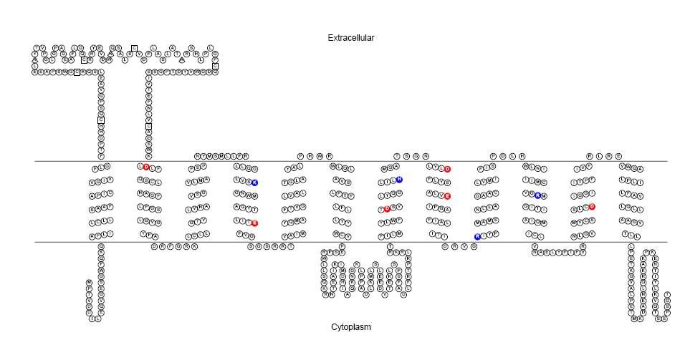
Secondary Structure Prediction hOCT1 (Isoform a)
Blue: Basic Residue Red: Acidic Residue
Secondary Structure Prediction of hOCT1 using TMHMM Server v. 2.0 Display using TOPO2 server (UCSF)

Slide 49
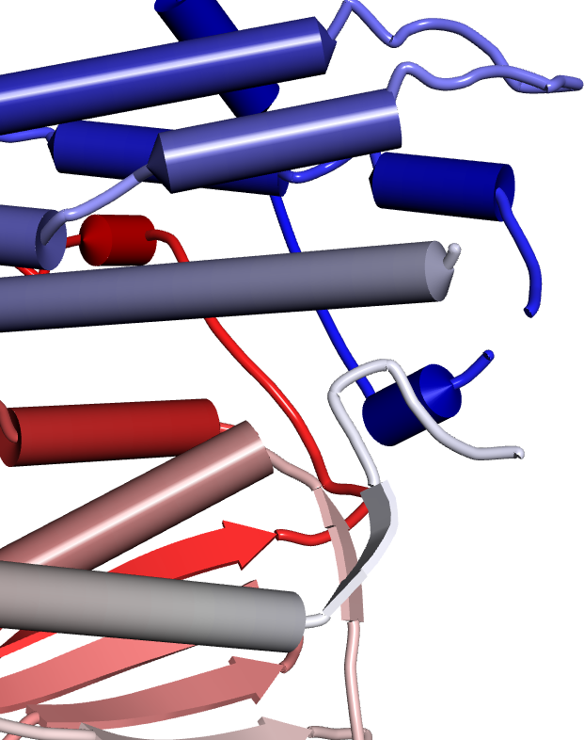
Missing Loops and regions
2BU2: HUMAN PYRUVATE DEHYDROGENASE KINASE 2
Gap2
Gap1

Slide 50
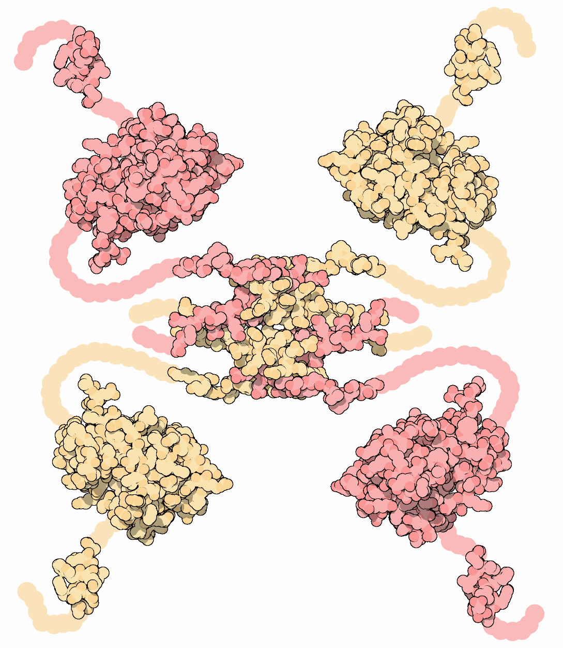
Many domains are missing
Four chains come together to form a complex that will hold the DNA
This complex is not solved.
P53 Tumor Suppressor
Figures from the Molecule of the Month by David Goodsell (2002)

Slide 51
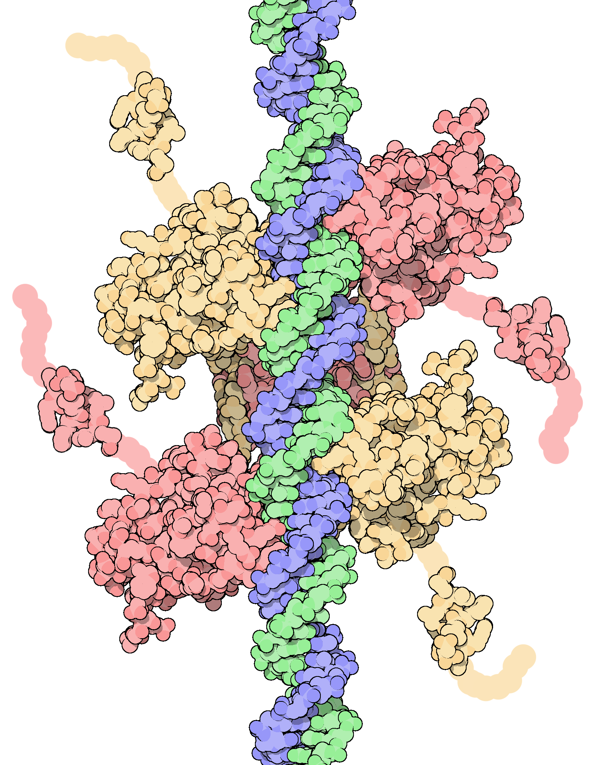
Schematic figure from the P53 DNA complex Molecule of the Month by David Goodsell (2002)

Slide 52
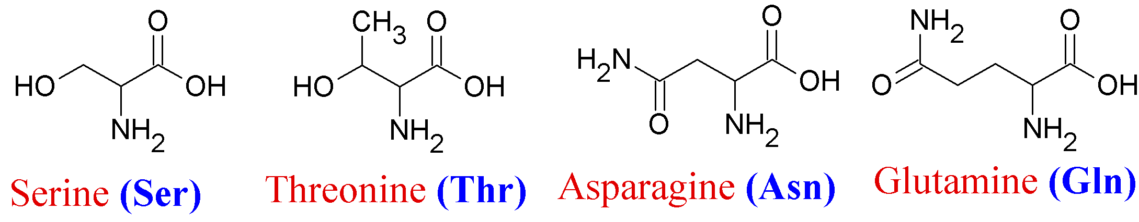
H-atoms
Most x-ray structures do not contain H atoms
Too small to be resolved in X-ray crystallography
NMR method can resolve Hs and so all Hs are present.
Two residues that are complicated by this lack of Hs are: Asparagine and Glutamine
Oxygen (8) and Nitrogen (7) have almost same electrons; similar size;
So, without Hs they can be often mis-identified
Modeling can help using surrounding atoms

Slide 53
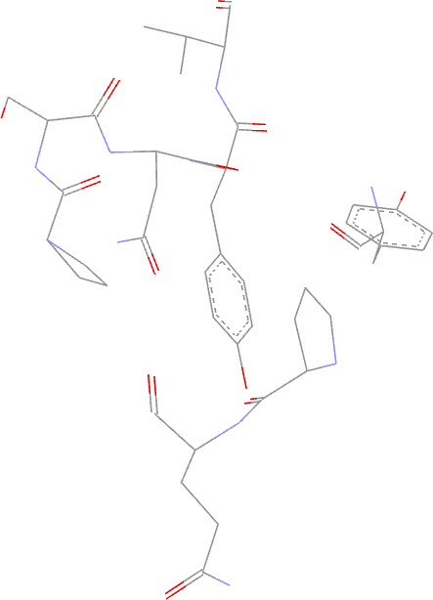
ASN Flip by example
2SRC
ASN135

Slide 54

2srcFH_reg-FLIPPED-MolProbity
ASN135
ASN135
GLN251
251GLN
2SRC-MolProbity
2SRC

Slide 55

Resolution
Resolution is a measure of atomistic detail in the experimental 3D structure. It reflects the quality of the data collected by the experimentalists
When all the molecules are aligned in the crystal, they give rise to strong diffraction and the resulting structure will be a high resolution one. (ex. < 1 Angstrom)

Slide 56
Resolution
If some of the molecules are mis-aligned due to mobility, then the diffraction pattern is not strong and the electron density maps will not contain all the atomistic details (usual structures are around 2.5 to 3.0 Ang)
Quality of size of the crystal can also influence the resolution
Big crystals → high resolution structures

Slide 57

PDB IDs
1a6m 106m 108m 1s0h
Image taken from http://www.rcsb.org/pdb/101/static101.do?p=education_discussion/Looking-at-Structures/resolution.html

Slide 58
Resolution
PDBs of human KRAS
PDB Method Res Chain Range 4EPR X-ray 2.00 A 1-164
4EPT X-ray 2.00 A 1-164
4EPV X-ray 1.35 A 1-164
4EPW X-ray 1.70 A 1-164
4EPX X-ray 1.76 A 1-164
4EPY X-ray 1.80 A 1-164
Which one is better?

Slide 59
R-values
Scientists as a first step build a model and simulate the diffraction data based on the model.
The R-value reflects the quality of the atomic model
It also explains how the simulated diffraction pattern agrees with the experimental diffraction pattern
How to judge the R-values. The base-line is a random set of atom model will give a R-value of 0.63 and a ideal fit would be 0 (model and experimental pattern are same)

Slide 60



Molecular Modeling: Visualization
Discovery Studio 1.6-a3b2 Receptor
Visualization
Free: Spdbv, Cn3D, PyMol, DiscoveryStudio, VMD and many more
$$$$: Accelrys, Schrodinger and many more
1ad5A:DeepView
R-Ifosfamide Discovery Studio ViewerPro 6.0

Slide 61
Selected Static Properties of Macromolecules

Slide 62

Solvent Accessibility (SA)
SA
SA help us to know what groups are on the surface-solvent exposed
Can give hints on the possible interaction with ligands etc.

Slide 63

Molecular Surfaces
OH
H C
O
o
Probe Solvent Sphere
Van der Waals radius of Oxygen
Van der Waals Surface
Solvent Accessible (Connolly) Surface

Slide 64


Molecular Surface
Hydrophobic residues on the Connolly surface of the protein for some reason! Protein-Protein Interactions
Lysozyme, Hydrophilic red, hydrophobic blue, InsightII, subsets are created using Engleman-Steitz algorithm

Slide 65
Solvent Accessibility
Goal is to identify binding interface

Slide 66



Structure → Solvent Accessibility
2LCX

Slide 67

Exposed
Buried

Slide 68


Exposed
Buried
One of the chain is hidden

Slide 69
Contact Map
Protein function is often decided by its 3D Shape and fold
Fold is often determined by what contacts the residues have with its surrounding residues
Surrounding residues of a residue may or may not be sequence neighbors

Slide 70
Contact Map
Provides a 2D representation of a 3D structure
3D structural elements have a unique shape in Contact maps
Helix, parallel/anti-parallel sheet etc.
Not affected by rotations or translations of the protein

Slide 71

1STP: Alpha Contact Plot
Anti-parallel sheet

Slide 72

1HLO: Alpha Contact Plot

Slide 73


Structure Flexibility
2LCX
C-TER
N-TER

Slide 74
Hydrophobicity
As implemented in DS-Visualizer
PHE 2.8 SER -0.8
MET 1.9 PRO -1.6
ILE 4.5 TYR -1.3
LEU 3.8 HIS -3.2
VAL 4.2 GLN -3.5
CYS 2.5 ASN -3.5
TRP -0.9 GLU -3.5
ALA 1.8 LYS -3.9
THR -0.7 ASP -3.5
GLY -0.4 ARG -4.5
Taken from Kyte, J.; Doolittle, R. F. A Simple Method for Displaying the Hydrophobic Character of a Protein. J. Mol. Biol.1982, 157, 105-132.
Usually a smoothing is often applied while calculating hydrophobicity:
A window of 5 is a good choice
i-2,i-1, I, i+1, i+2
The values are averaged over the neighboring residues. And if the final value is > 0.7 HYDROPHOBIC
Otherwise non-hydrophobic

Slide 75

Protscale Hydrophobicity
P06213 Human Insulin Receptor Receptor Tyr Kinase
TRANSMEM 957-979 Helical. {ECO:0000255}.

Slide 76
Secondary Structure Prediction hOCT1 (Isoform a)
Blue: Basic Residue Red: Acidic Residue
Secondary Structure Prediction of hOCT1 using TMHMM Server v. 2.0 Display using TOPO2 server (UCSF)

Slide 77
Crystal Structure
Symmetry Operations are Translations, Rotations and their combinations (screq axis)
Example Unit Cell
Asymmetric Unit
Smallest Portion of a Crystal
Two-fold rotation
Based on RCSB help pages

Slide 78
Additional Information of Symmetry
A crystal asymmetric unit may contain:
one biological assembly (Ex. 2HHB)
part of a biological assembly (Ex. 1hho)
multiple biological assemblies (Ex. 1hv4)
Example Unit Cell
Asymmetric Unit

Slide 79

Does the biological assembly always contain multiple chains?
PDB:
7DFR

Slide 80
PDB: Complete Structure?
Just because you have a structure entry doesn’t mean that
It has all the residues from end-to-end
O95696; 1058 total length; only fragments are solved
All the atoms
Only alpha carbons; 1f6g
ATOM 1 CA MET A 1 3.492 3.121 59.151 1.00 0.00 C
ATOM 2 CA PRO A 2 6.043 5.372 57.455 1.00 0.00 C
ATOM 3 CA PRO A 3 7.095 2.832 54.786 1.00 0.00 C
ATOM 4 CA MET A 4 3.532 1.921 53.915 1.00 0.00 C
ATOM 5 CA LEU A 5 2.613 5.557 53.443 1.00 0.00 C
ATOM 6 CA SER A 6 5.641 6.166 51.259 1.00 0.00 C
ATOM 7 CA GLY A 7 4.784 3.239 49.020 1.00 0.00 C
ATOM 8 CA LEU A 8 1.243 4.494 48.588 1.00 0.00 C
ATOM 9 CA LEU A 9 2.481 7.928 47.597 1.00 0.00 C
ATOM 10 CA ALA A 10 4.813 6.418 45.031 1.00 0.00 C

Slide 81
Protein
Conformation
Spatial arrangement of atoms in proteins
Native states: For a given conditions, the conformations that are existing with lowest Free Energy are also thermodynamically stable states
∆G under physiologically stable conditions are 25-65 kJ/mol (Lehninger Biochemistry)
Protein conformation is made up of strong (covalent) and many many weak (H-bonded, hydrophobic etc)
These weak interactions rule the protein world

Slide 82
Protein
Hydrophobic interactions (core)
Charged residues in the core should interact using H-bonded/salt bridge (core)
Hydrophilic interactions in the surface
Interaction with solvent

Slide 83
Molecular Graphics
Discovery Studio
VMD
DeepView

Slide 84
How to build model proteins?
Homology Modeling
Ab-initio

Slide 85

CASP: Test of the Models
Critical Assessment of Techniques for Protein Structure
http://predictioncenter.org/
Showcase for the latest methods in the structure prediction area
Once in two years
Competition open in three areas
Homology Modeling, Threading and ab-initio
CASP (1998-) showed the reliability of Homology Modeling when suitable templates are available (>30%, above Twilight Zone)

Slide 86
CASP Competition categories
CASP categories
Template-based modeling
Template-free modeling
Servers that did well in the blind structure predictions
I-TASSER, Rosetta and HHpred
These have been shown to create models with accuracy on par with human-intervened software

Slide 87

What did we learn from CASP
CASP 7-11 Number one in the server category
CASP12 is scheduled to take place during May-August 2016

Slide 88
After Class Work
Complete the Self-test Quiz and the following computer labs:
13-2
13-4
13-6
13-7

Slide 89
Thanks Ravichandran S.
ravichandran@hood.edu

